Slide 1
Maintenance Page ODOO (official TuTORIAL)
Created by: Dennis Wong
DATE CREATED: 30 April 2025

Slide 2
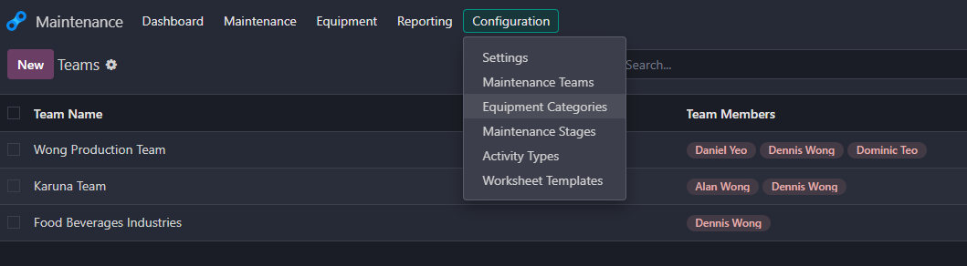
Step to use dashboard maintenance
Please Select Configuration from maintenance page and select maintenance teams
From there you can create new teams by clicking new button and fill in the blank for your team, specifying what team are you on.
After creating a new team, please select the team members, appointing all members involved. This is whether it is based on company, or projects or any kind of event involved.
Speaking of adding new members…(Next Slide about Equipment Categories)

Slide 3
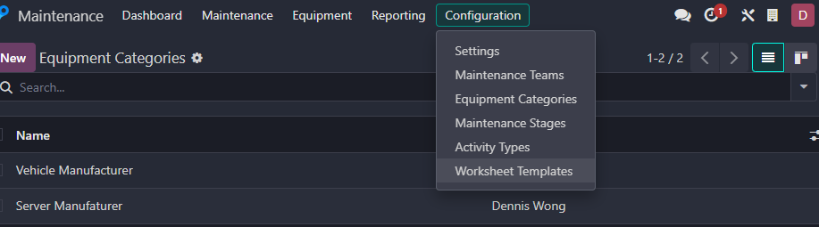
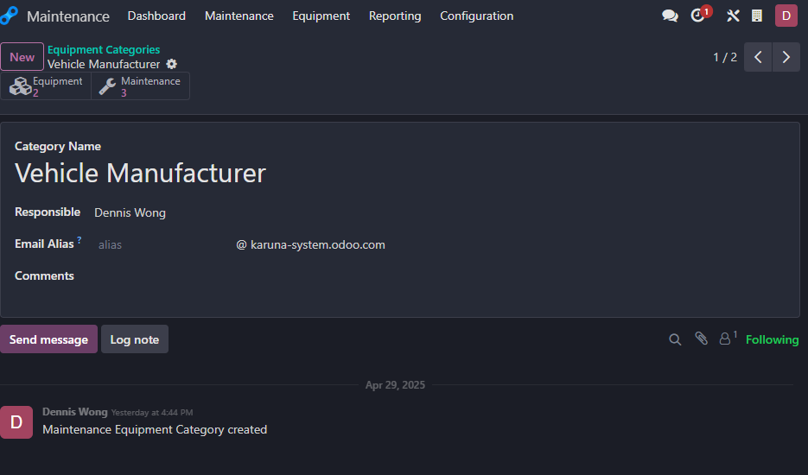
For Equipment, you might need equipment categories which can be selected from configuration.
From here you can create new kind of categories as this would be the main part for categorises all the equipments.
Speaking about responsible, normally will would be team lead or owner to deal with this.
For that name there is an arrow beside the name. Use it if you need new name if doesn’t involve in the list but only in occasion that you doesn’t use their account.

Slide 4
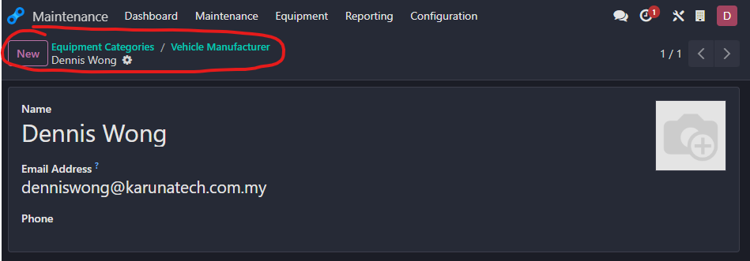
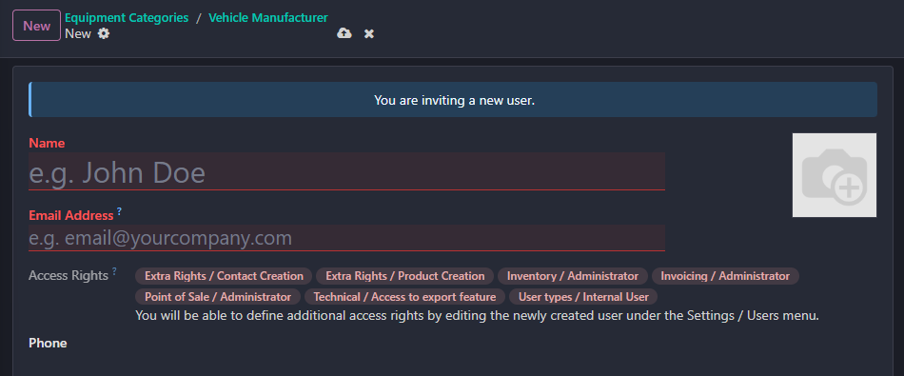
This is the place where you can add new names and email. Normally it is used to connect with the existing email if involved. (Currently it is used as demo)
After filling name and email address, please select cloud one to save the list.
After saving it, it would automatically show when you add the members when you open configuration to put team members.

Slide 5
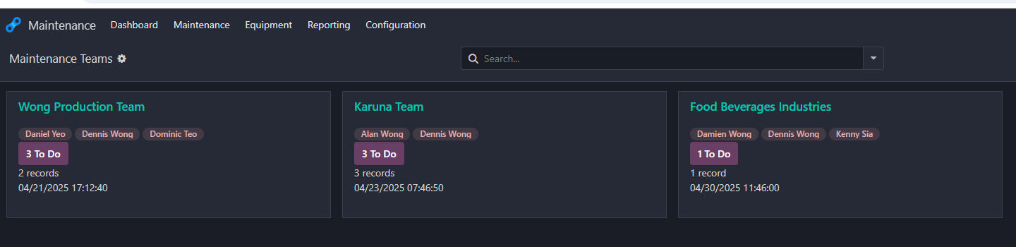
How to use dashboard, maintenance and equipment
The dashboard should be like this form. Normally I will discuss how normally works.
Following the few slides before, there you have the maintenance team that would show who are in the team, the total task involved to do with and the total records which is what equipment are using.
However, same equipment wont count twice but those devices would be under that team. For example, server 1 and server 2 are own by Karuna Team which has different capabilities. That is why it has that kind of record as you can see I have 3 servers inside Karuna Team.
When proceeding the button to do, it would go to the maintenance page. But I would show you the difference on the next slide.

Slide 6
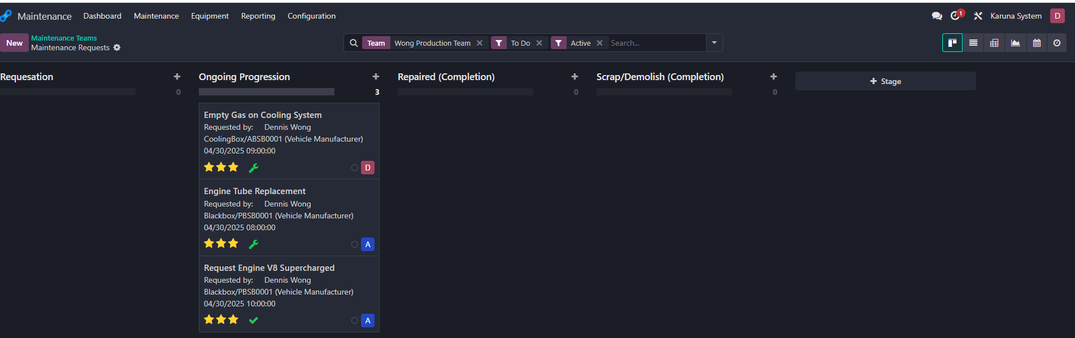
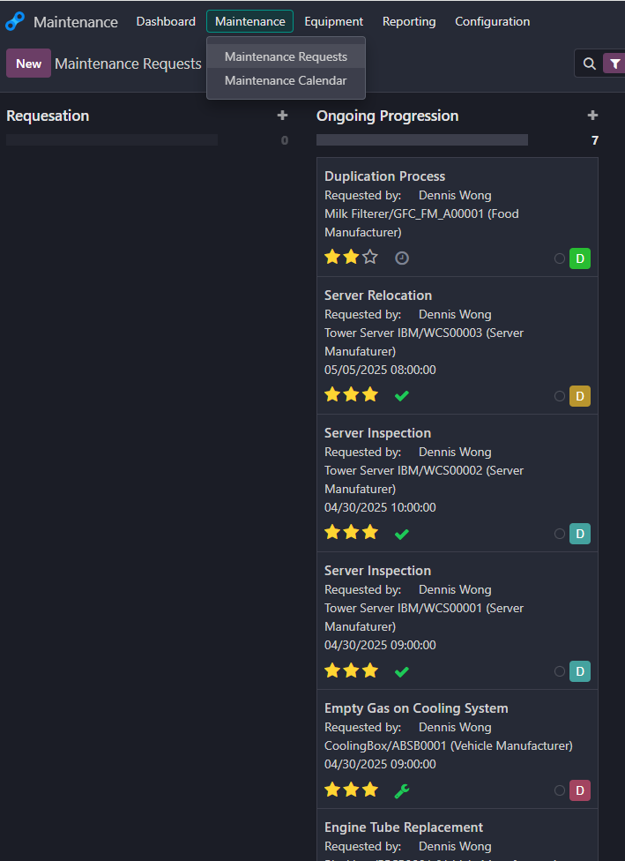
Here is the differences between clicking the maintenance through the dropdown section and clicking to-do under dashboard.
From clicking to-do, the section you will get is only specific based on maintenance teams.
As for the direct dropdown which is maintenance requests, it shows all the progress for all teams involved.

Slide 7
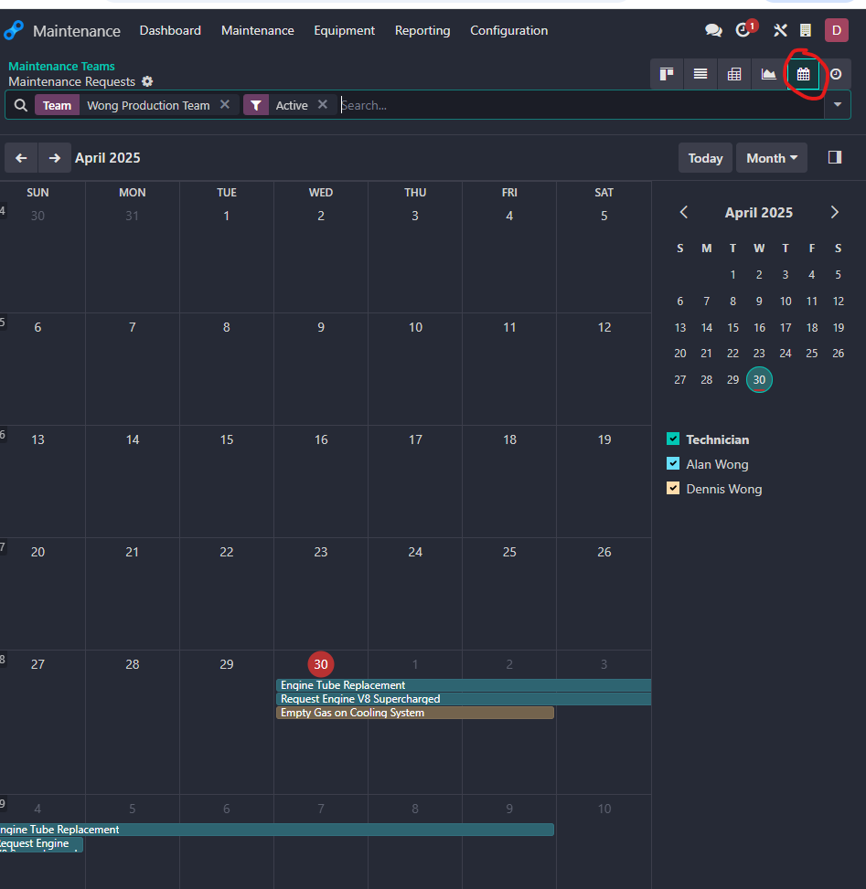
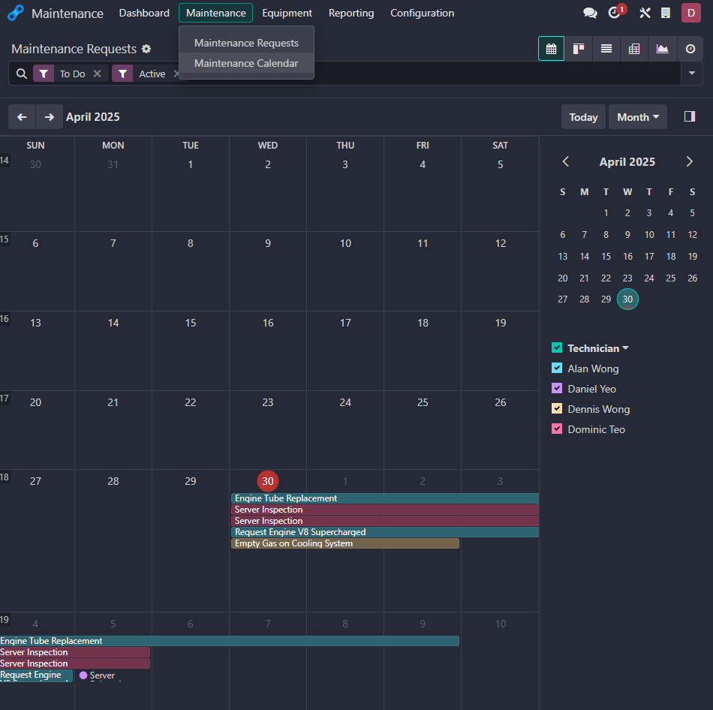
The left side is the calendar for specific team chosen just like the previous slide, I also circle the part when it opens the calendar part.
The right side is basically for the maintenance dropdown session which is maintenance calendar and it would show all teams involved in specific timeline.
Speaking of which, the colour represents the person who handle the task.

Slide 8
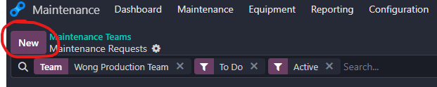
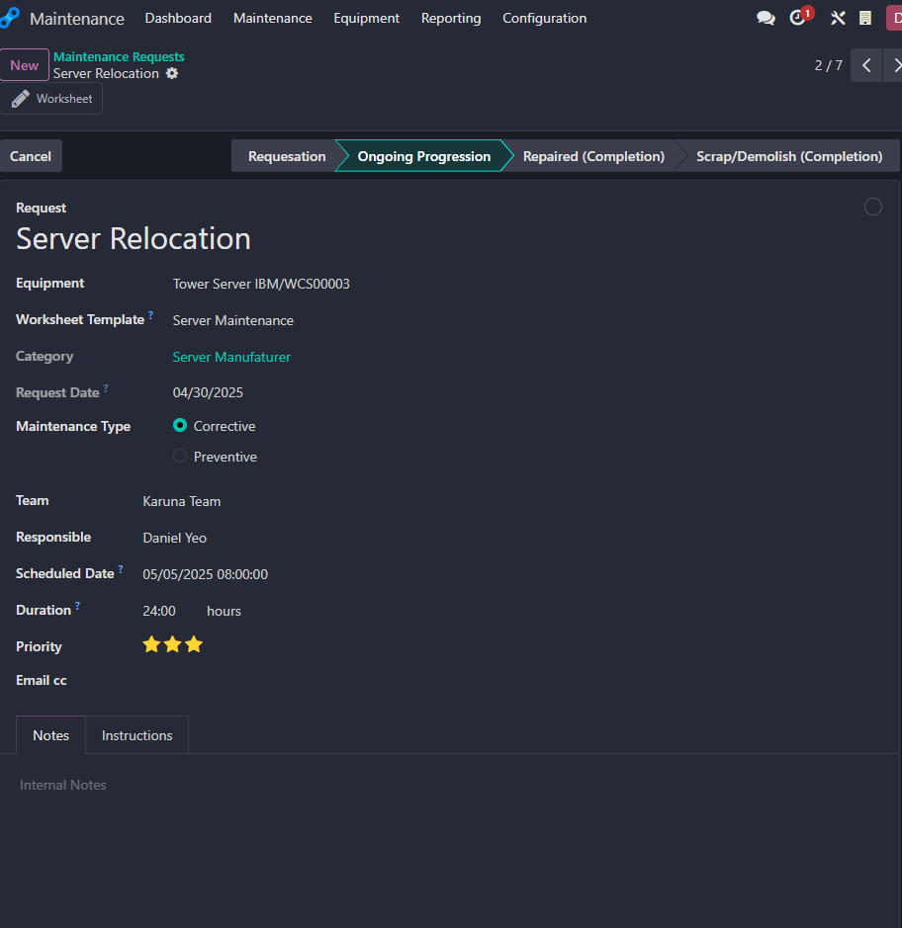
From Maintenance Page, if going to request, Please click the new button as I circled. It would go to the blank page which is the picture below (although it is filled).
From here the Request section is for what kind of topic that you are going to do, based on my request on that picture, I put the name server relocation. (basically I mention is to manage files rearrangement to another new server or some sort)
AS for the equipment, you will get the selection of equipment which is already create from equipment page (which would later show you) . Anyway select the equipment you want to focus/fix.
For the worksheet template go to the next slide later. Because that part is basically provide a template specifically for that maintenance category.
Speaking of category, as I mentioned that equipment you involved before is under “THAT” category involved.
For maintenance type, it is a condition for prevention or correction part. (Not sure for what usage but it is on informative session)
As for the team, which is maintenance team you selected, under who’s responsible would be the owner or who’s in charge. Could be team lead.
Schedule Date is set for specific date and time to start the task and duration part is for how many time you would spend. That duration I believe is used for record this task involved for how much time is used.
Priority part has 3 stars which consists from low to high. But I believe it is based on how important it is for this task.
As fir Email cc, it could be the notification to send to revenant member involved with the team to proceed the task. (this part I’m not sure as I didn’t use any)

Slide 9
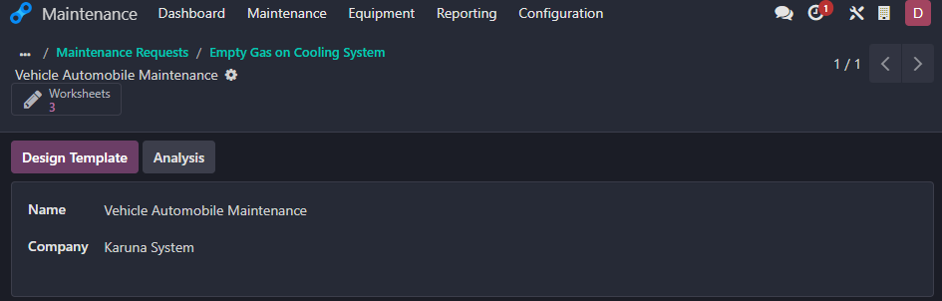
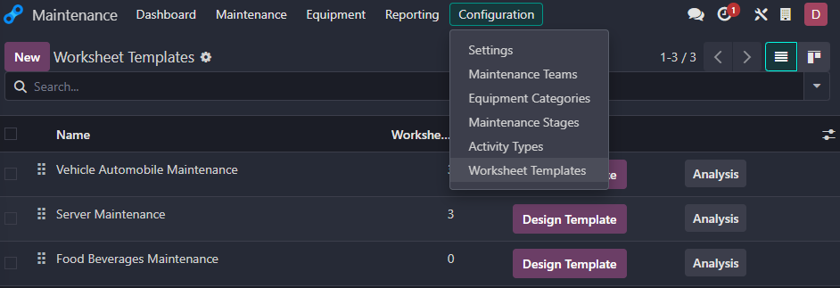
For the worksheet template mentioned by previous slide, this is how the page is, or rather it has few information
Also if need to create new worksheet templates, open configuration and go open worksheet templates.

Slide 10
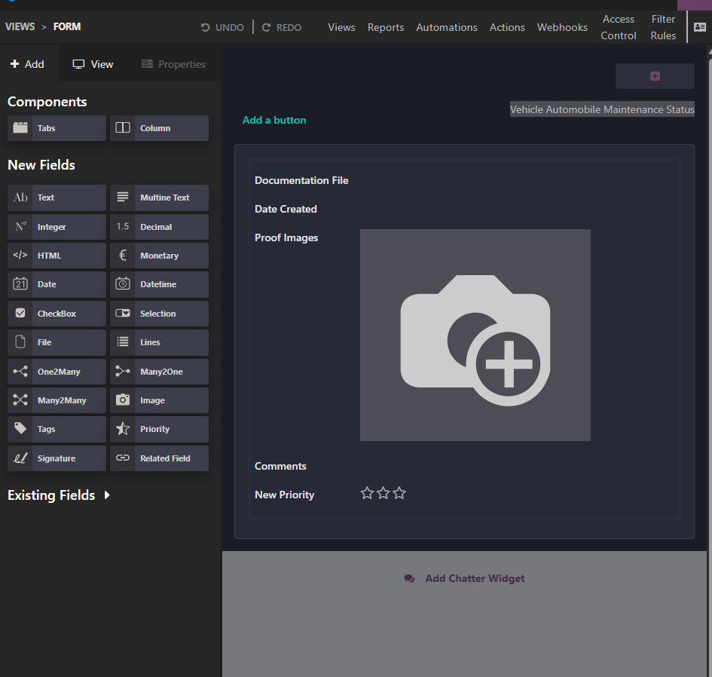
Speaking of Design template, This is not a complete form yet so when you open through newly created worksheet template or existing worksheet template. You will go through a section where all the tools available. This is where the programmers/designer comes in to set up the form.
I’m still figuring out all the function as for now. (many2one, html, monetary, checkbox, selection, tags, related field and signature not yet tested)
The problematic is many2one, but ignore the one2many and many2many as we don’t use that often but would be research thoroughly as well. Speaking of problematic:
Where the team member comes from…(which im going to put based for the project given)

Slide 11
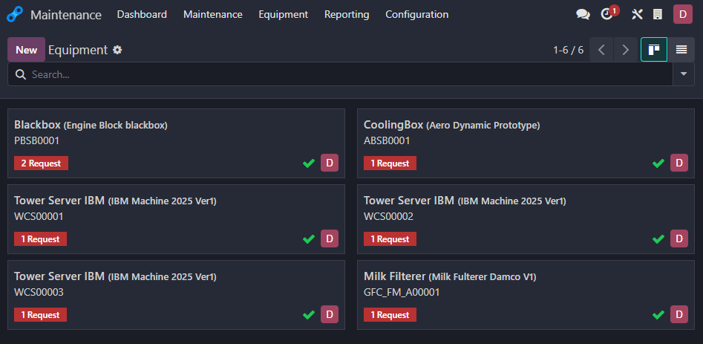
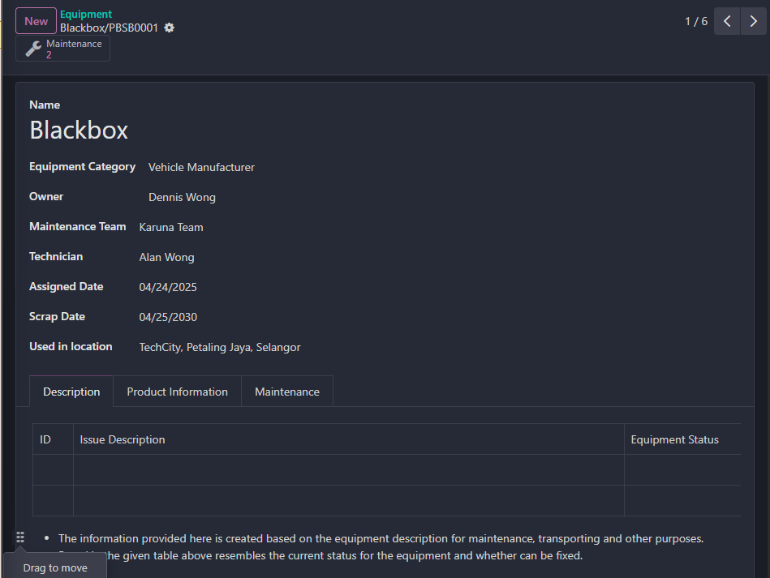
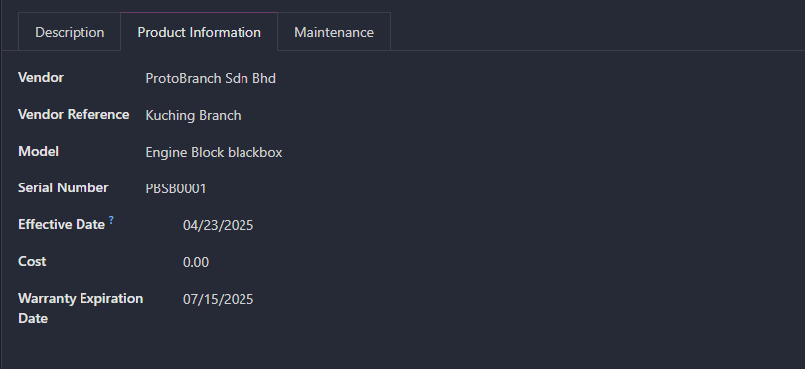
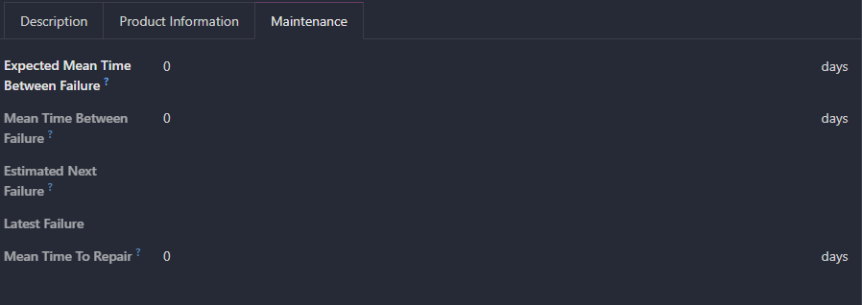
Create equipment's that involves on businesses

Slide 12
Create equipment's that involves on businesses (cont.)
As provide the picture in previous slide, here is the equipment page where you can create new equipment here. All the list show here are the general details for that equipment.
When creating new equipment, as previous slide shows the existing data as most of the information are interrelated to maintenance page.
Name is basically the name of the equipment/product. As for the information:
Equipment category is what the product is under what kind of category or rather under the company section.
Ownership under company name or owner name
Maintenance team is whom team controls
Assigned Date is for the product has been assigned to that company (THAT depends on business decision)
Scrap Date is the product whom might be replaced (THAT depends on business decision)
Used in location, follow based on company details where the equipment stores.
For description, you can make any kind of information but for my example, I use it for record the history that involves the maintenance here. But any kind of information will do which is relevant to this equipment
As for production information, follow the company regulation for every equipment. (standard procedure)
Maintenance part, ignore this one for the time being as I’m not yet confirm. But according to the information, this is based on the equipment expected to fix around estimated time and what kind of reason involved. Also it involves how much time to repair the equipment.

Slide 13
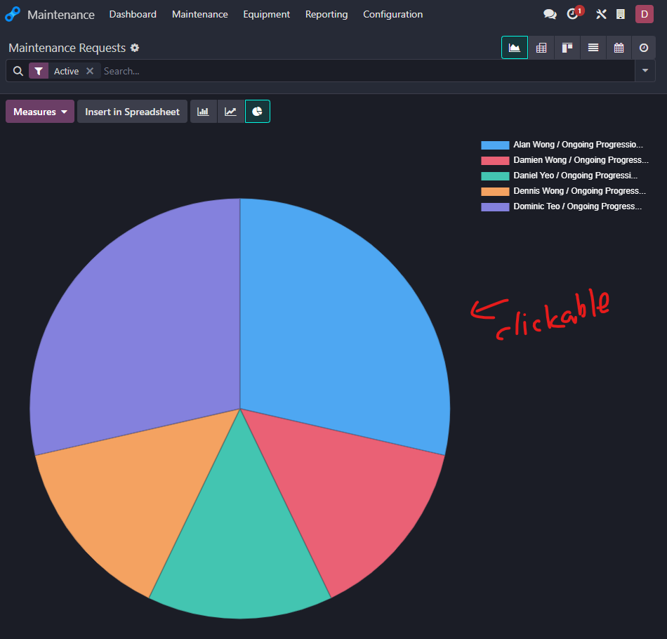
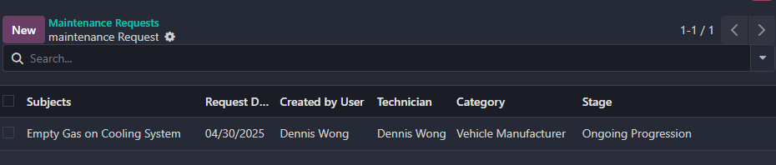
Reporting session
AS for the report part, just select through reporting to show dropdown where the maintenance request shown, click that and it would show the chart, bar chart or graph given.
For what the picture involves here is the chart section where the pie chart can be clickable.
Example here as I click the yellow pie chart and the second picture show the result where the current ongoing task is there.
Every colour represents the person who carried the task. You can select that part and look the description yourself as it is just basically the same as shown in slide seven there (although this is different information only).

Slide 14
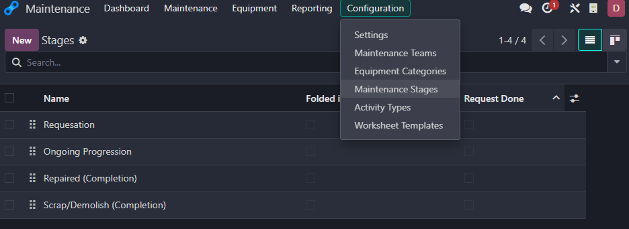
Configuration – Maintenance Stages
This is task based where it would involved in maintenance page.
Those stages involved normally can be renamed but I wont recommend for any checked in both section which is:
Folded in Maintenance Pipe
Request Done

Slide 15
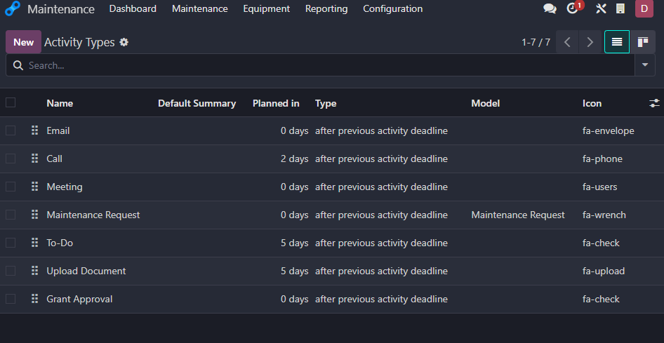
Configuration – Activity Types
This is where the activity involves.
Currently I’m not yet touch this part yet. Would research in this part. But for what understands, this is most likely would involved for bar scan later or any activities. (IMPORTANT)

